Slide 1
Prime Time
Fayza Hamada

Slide 2

Why we use Prime Time?
Static Timing Analysis

Slide 3
PrimeTime
PrimeTime is the Synopsys stand-alone sign-off quality static timing analysis tool that is capable of performing extremely fast static timing analysis on full chip-level designs.
PrimeTime validates the timing performance of a design by checking all possible paths for timing violations without using logic simulation or test vectors.
the report can also contain other debugging information like the fanout or capacitive loading of each net.

Slide 4
Static Timing Analysis
The static timing is performed both for the pre and post-layout gate-level netlist.
Pre-layout mode, PrimeTime uses the wire load models specified in the library to estimate the net delays and constraints.
Post-layout mode, the actual extracted delays are back annotated to PrimeTime to provide realistic delay calculation (net capacitances and interconnect RC delays)
Static timing analysis is also an iterative process

Slide 5
PrimeTime Inputs and Outputs
Gate-level netlist
Libraries
SDF
Parasitics
PrimeTime
Design Constraints
Initial timing reports
Saved session
Restore session in PrimeTime for further debugging

Slide 6
Physical Synthesis Flow Using PrimeTime
RTL description
Technology library
.db
Timing constraints for resynthesis and logic optimization
Cell delays, transition times, capacitance, wire load models, design rules, operating conditions
Synthesis
.lcctcl, .sdc
PrimeTime
(Static Timing Analysis)
Gate-level description
Design data
Command-specified conditions
.db, Verilog, VHDL
.tcl
.sdc
.pt
Place & Route
Path constraints
.sdf
Chip layout description
Delay data; detailed parasitic data for back-annotation
Timing models
.sdf; RSPF, DSPF, SPEF, SBPF
.db, interface logic models, extracted timing models
Design sign-off

Slide 7
Design Entry
PT being the static analysis engine can only read mapped designs. This performs the basis of design entry to PT.
input to PT can be a file in db, Verilog, VHDL or EDIF format.
read_db –netlist_only .db #db format
read_verilog .sv #verilog format
read_vhdl .svhd #vhdl format
read_edif .edf #EDIF format
–netlist_only option >>This prevents PT from reading the constraints and/or other attributes associated with the design only structutal netlist.

Slide 8
Propagating the Clock
Propagating the clock is usually done after the layout tool inserts the clock tree in the design, and the netlist is brought back to PT for STA.
The clock is propagated through the entire clock tree network
the delay across each cell in the clock tree and the interconnect wiring delay between the cells is taken into account
set_propagated_clock <clock list>

Slide 9
What to Analyze?
In general, four types of analysis is performed on the design, as follows:
From primary inputs to all flops in the design.
report_timing –from [all_inputs] –to [all_registers –data_pins]
b) From flop to flop.
report_timing –from [all_registers –clock_pins] –to [all_registers –data_pins]
c) From flop to primary output of the design.
report_timing –from [all_registers -clock_pins] –to [all_outputs]
d) From primary inputs to primary outputs of the design.
report_timing –from [all_inputs] –to [all_outputs]

Slide 10
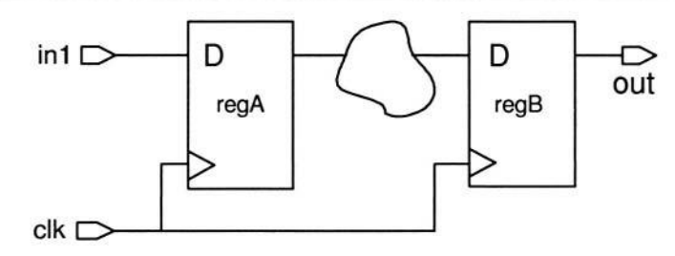
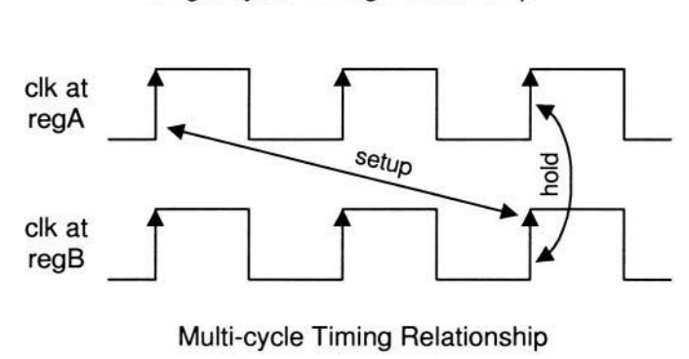
Multicycle Paths
In the multicycle mode, the data may take more than one clock cycle to reach its destination.
set_multicycle_path <multiplier value> –from <from list> –to <to list>
Ex)set_multicycle_path 2 –from regA –to regB

Slide 11
False Paths
A false path is identified as a timing path that does not propagate a signal.
set_false_path –from <from list> –to <to list> –through <through list>
This command does not disable the timing arc of any cell, it merely removes the constraints of the identified path.
Do not define false paths for registers belonging to separate asynchronous clock domains alternative is to set the false paths on the clocks itself
set_false_path –from [get_clocksCLK1] –to [get_clocks CLK2] set_false_path –from [get_clocks CLK2] –to [get_clocks CLK1]

Slide 12
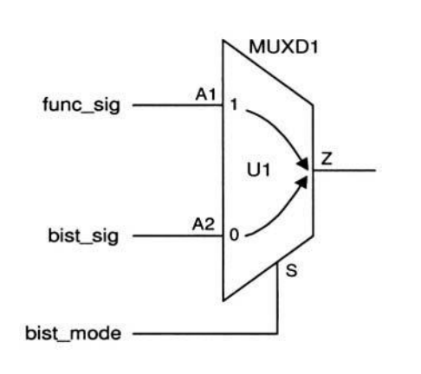
Case Analysis
By setting a logic value to the bist_mode signal, all timing arcs related to the bist_mode signal are disabled/enabled.
the following command disables
the timing arc from A2 to Z:
set_case_analysis 1 bist_mode.

Slide 13
Post-Layout
The post-layout steps involve analyzing the design for timing with actual delays back annotated.
These delays are obtained by extracting the layout database.
The analysis is performed on the post-routed netlist that contains the clock tree information.
This involves analyzing the design for both the setup and hold-time requirements.

Slide 14
What to Back Annotate to PT?
It is recommended that the following types of information be generated from the layout tool for back annotation to PT in order to perform STA:
d) Net RC delays in SDF format.
e) Capacitive net loading values in set_load format.
F) Parasitic information for clock and other critical nets in DSPF, RSPF or SPEF file formats.
The following PT commands are used to back annotate the above information:
read_sdf: As the name suggests, this command is used read the SDF file. For example:
pt_shell> read_sdf rc_delays.sdf

Slide 15
What to Back Annotate to PT?(cont)
source: PT uses this command to read external files in Tel format.
Therefore, this command may be used to back annotate the net
capacitances file in set_load file format. For example:
pt_shell> source capacitance.pt
read_parasitics: This command is utilized by PT to back-annotate the
parasitics in DSPF, RSPF and SPEF formats. You do not need to specify
the format of the file. PT automatically detects it. For example:
pt_shell> read_parasitics clock_info.spf

Slide 16
Post-Layout Clock Specification
The following commands exemplify the post-route clock specification.
pt_shell> create_clock –period 20 –waveform [list 0 10] [list CLK]
pt_shell> set_propagated_clock [get_clocks CLK]
the set_propagated_clock command propagates the clock throughout the clock network.
Since the clock tree information is now present in the design, the delay, skew, and the transition time of the clock is calculated by PT, from the gates comprising the clock network

Slide 17
Pre-Layout Clock Specification
The following commands may be used to define the clock, during the prelayout phase of the design.
create_clock –period 20 –waveform [list 0 10] [list CLK]
set_clock_latency 2.5 [get_clocks CLK]
set_clock_transition 0.2 [get_clocks CLK]
set_clock_uncertainty 1.2 –setup [get_clocks CLK] set_clock_uncertainty 0.5 –hold [get_clocks CLK]

Slide 18
Analyzing Reports
Extensive analysis is performed using the following commands:
report_timing –to [all_registers –data_pins] –delay_type min
report_timing –to [all_outputs] –delay_type min
report_constraint -all_violators -significant_digits 4 > \
../results/johnson.max_constr.rpt

Slide 19
Thanks

